Slide 1


CODE BRIGADE
Team members:
Abdhul Hazeez
Chenthan Kumar
Jithin Krishnan
Manya P.V

Slide 2

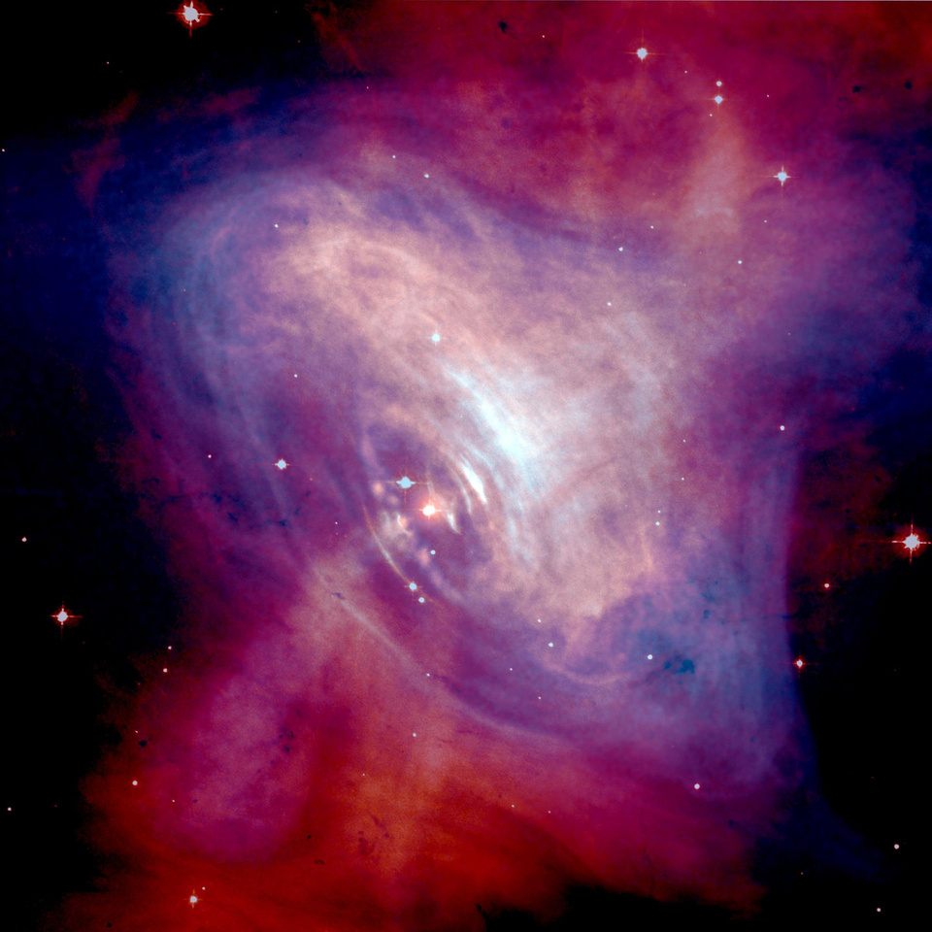
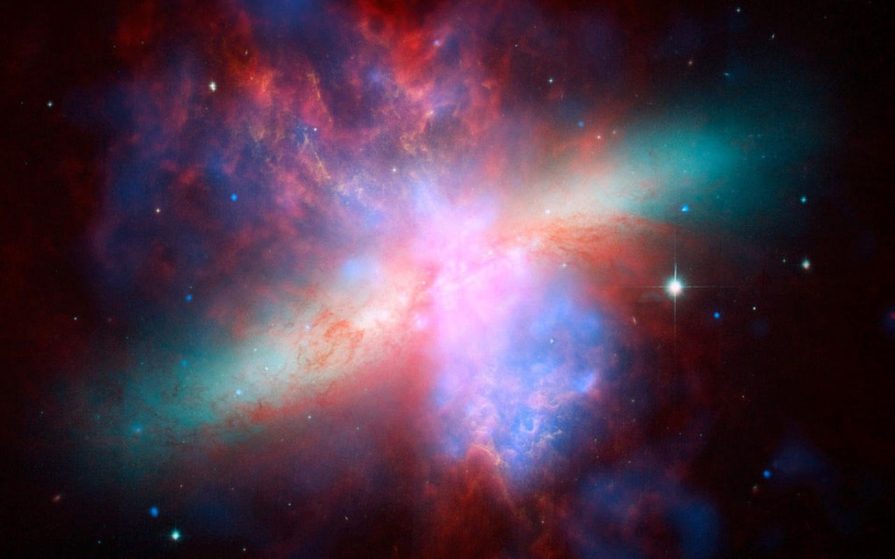

CODE BRIGADE
PROBLEM STATEMENT
Data collection
Real-Time Data Processing
Anomaly Detection
Reporting and Visualization
Early Fault Detection
Ensures Safety and Reliability
Informs Critical Decision-Making
Extends Spacecraft Lifetime
What is Telementry analysis?
Who is affected ?
Why is Telemetry analysis important for Spacecraft?

Slide 3
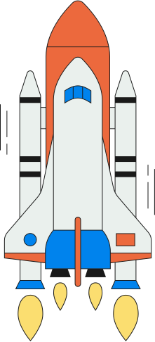

CODE BRIGADE
OUR SOLUTIONS
Upload Telemetry Data
Analyze and Detect Anomalies
Generate Voice & Visual Alerts
Output Graphs and Reports
System Health Status

Slide 4
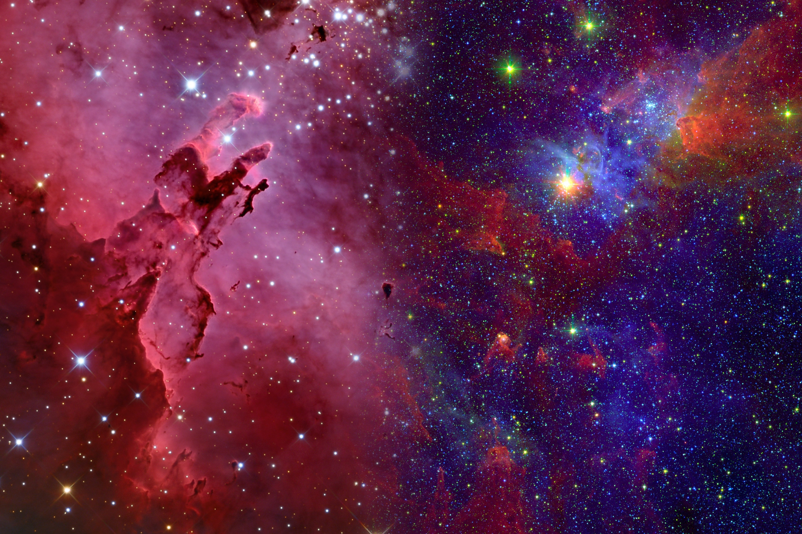

CODE BRIGADE
SYSTEM ARCHITECTURE
UPLOAD
PARSE & ANALYZE
DETECT ANOMALIES
GENERATE ALERTS
DOWNLOAD REPORT

Slide 5
CODE BRIGADE
TECHNOLOGIES STACK
Python
Streamlit
Pandas
Matplotlib
pyttsx3 (Voice alerts)
OpenPyXL (Excel output)

Slide 6




KEY FEATURES
Real-time anomaly detection
AI-based voice alerts
Interactive graphs
Tabled sensor data view
Downloadable Excel reports

Slide 7
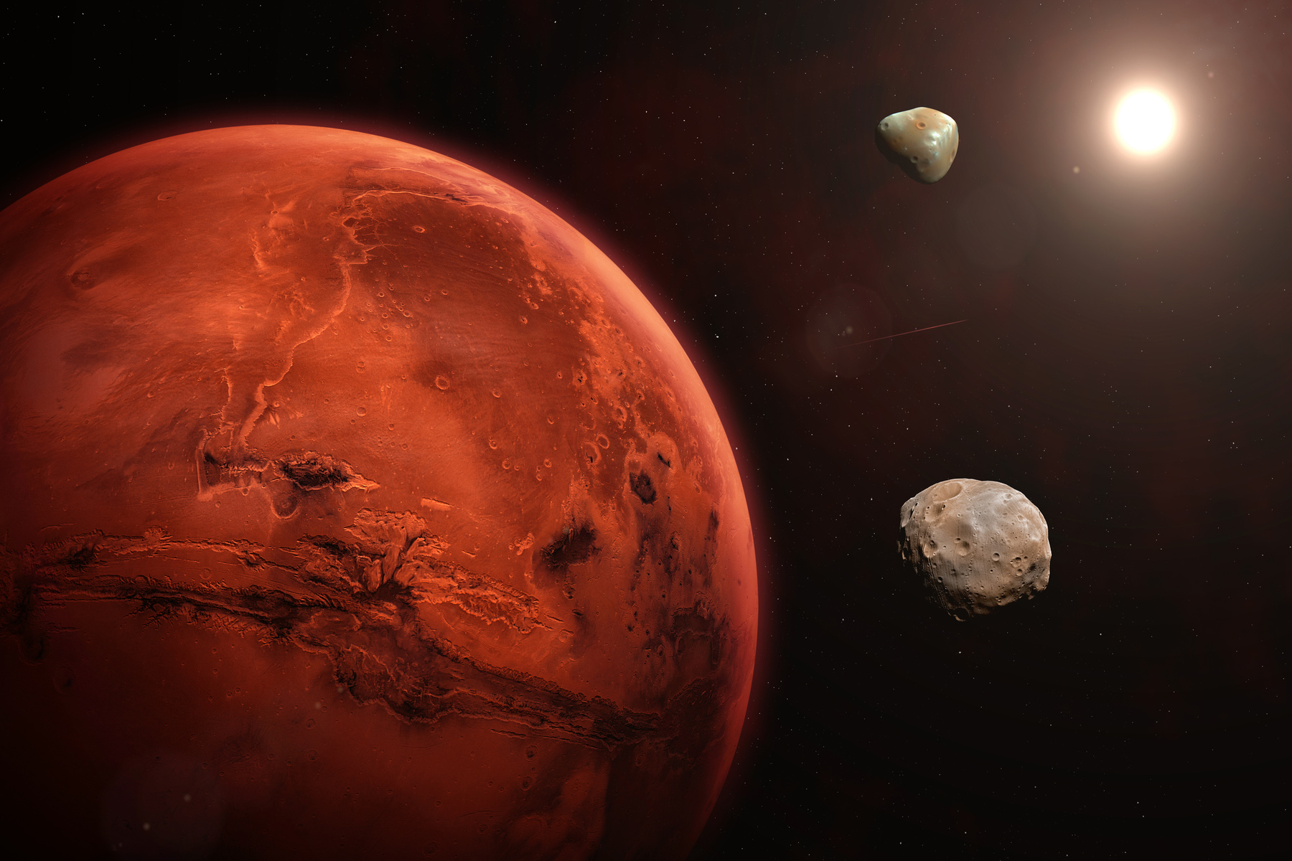

DATA FORMAT
Timestamp: Date and time of the telemetry reading (format: DD-MM-YYYY HH:MM)
Temperature: Temperature readings in °C
Pressure: Pressure readings in atm
Velocity: Velocity readings in m/s
Battery: Battery level percentage
Fuel: Fuel level percentage

Slide 8


Warner & Spencer
MISSION
PROFILES
The application comes with pre-configured parameter
thresholds for different mission types:
AddLEO Satellite
Deep Space Probe
Mars Mission
Venus Orbiter
Lunar Lander
a subheading
You can also create and save custom profiles with your own threshold values.

Slide 9

RESULTS
Streamlit for the web application framework
Plotly for interactive 3D visualizations
Matplotlib for 2D plotting capabilities
2D time-series plots for each telemetry parameter
3D scatter plots and mesh visualizations of multiple parameters
Health status gauges for quick system assessment

Slide 10
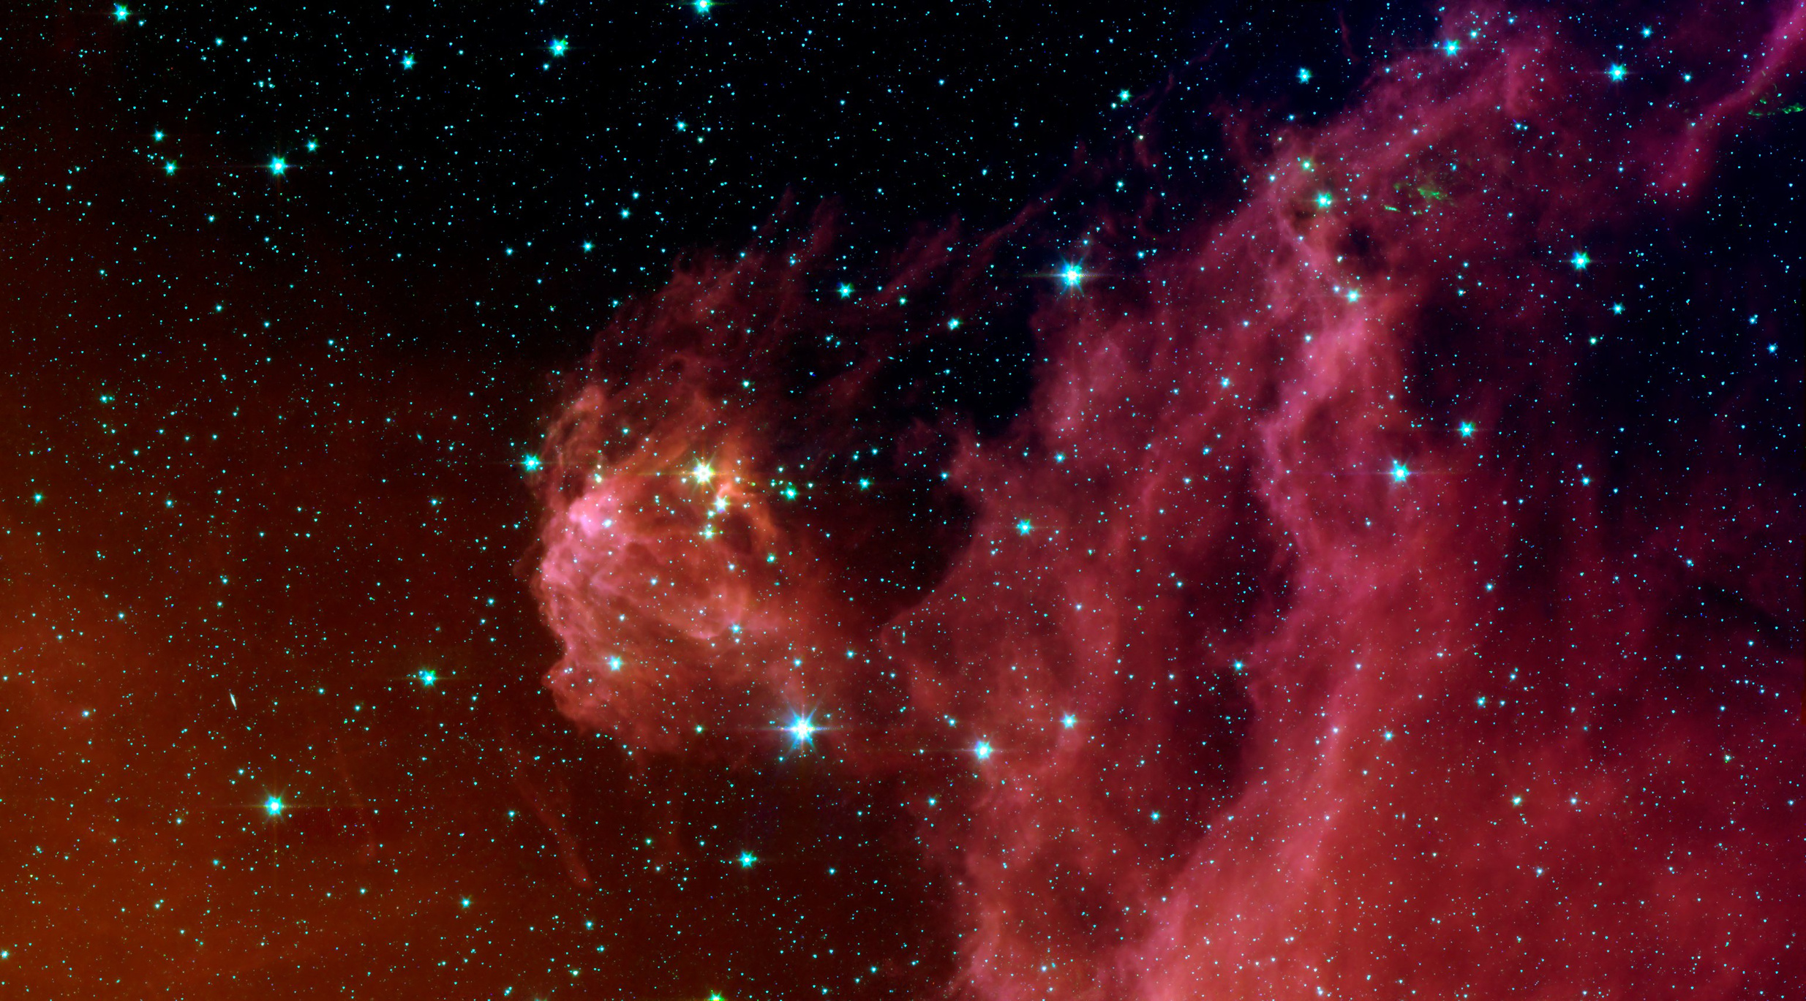
CODE BRIGADE
THANK YOU

